Slide 1
OBSERVANCE OF WORLD LEPROSY DAY
31st January, 2025.
Department of Psychology
Govt. Hrangbana College

Slide 2


Slide 3
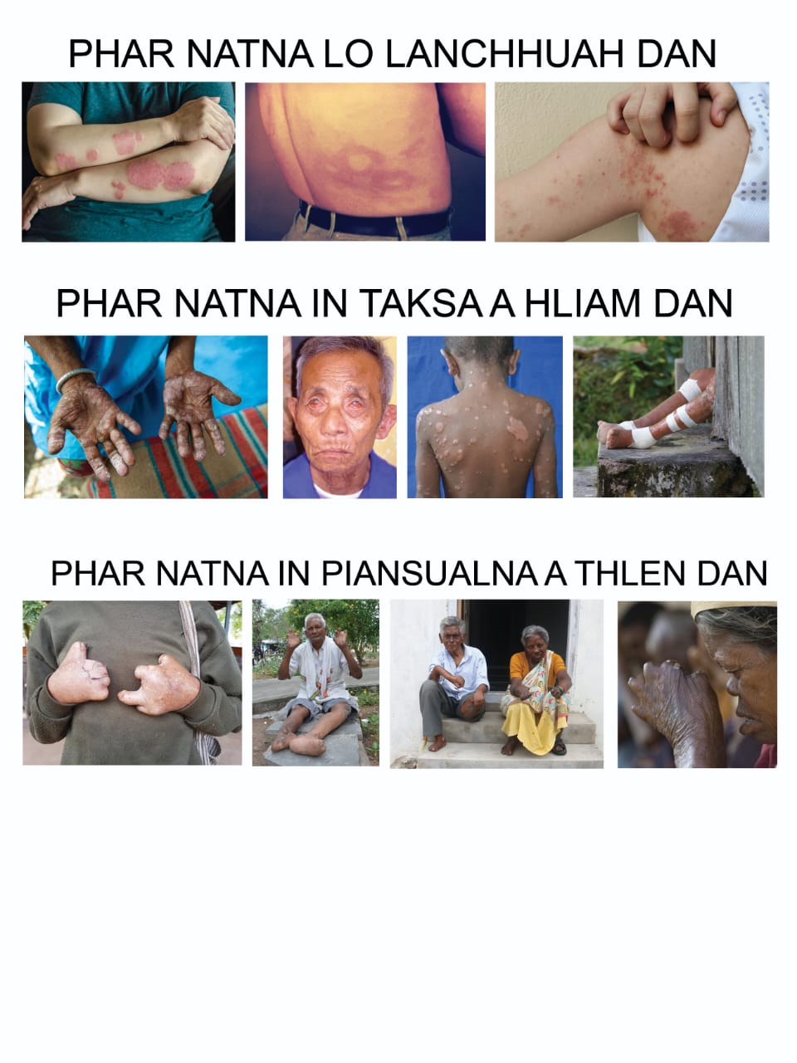

Slide 4
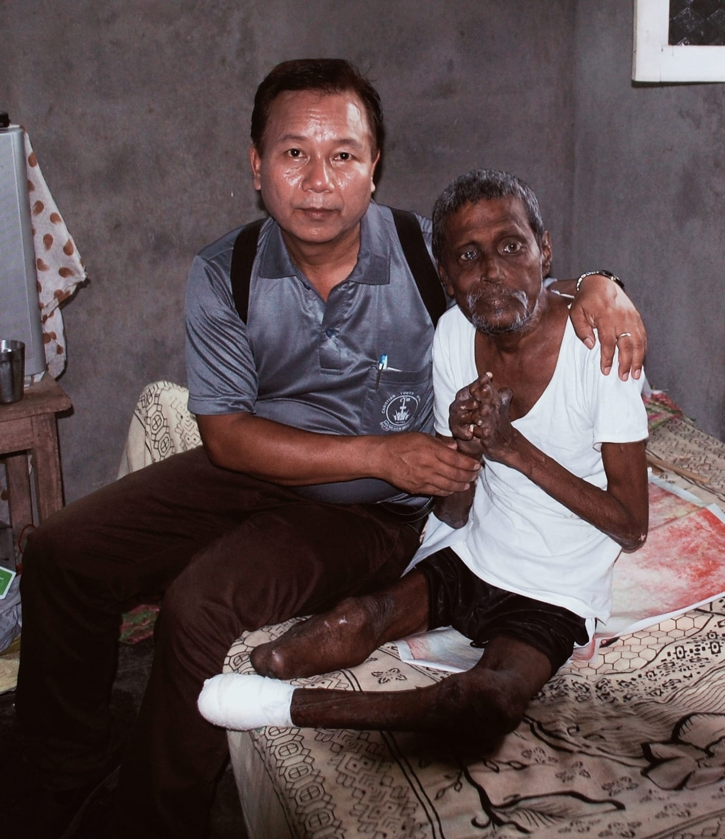

Slide 5
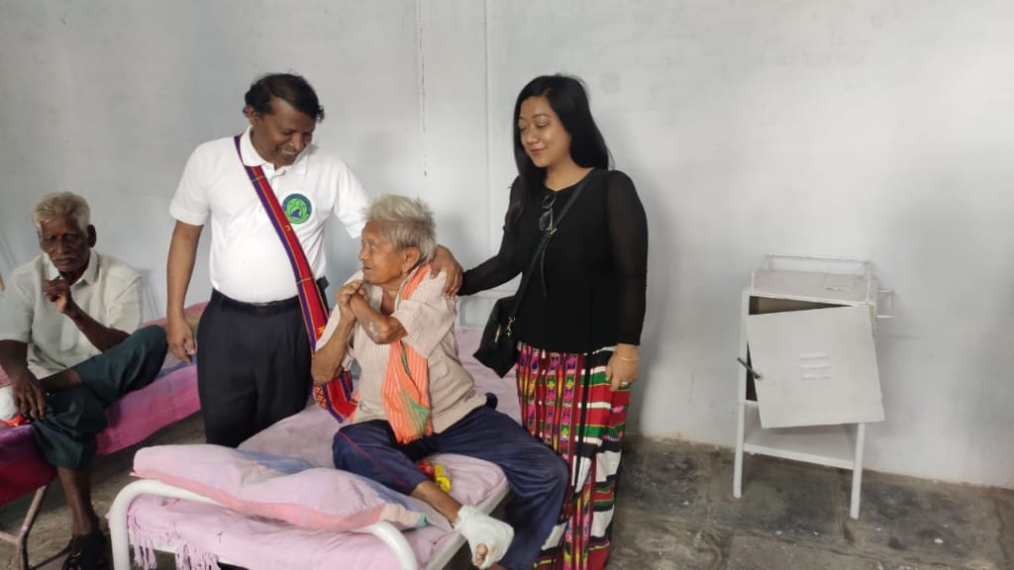

Slide 6
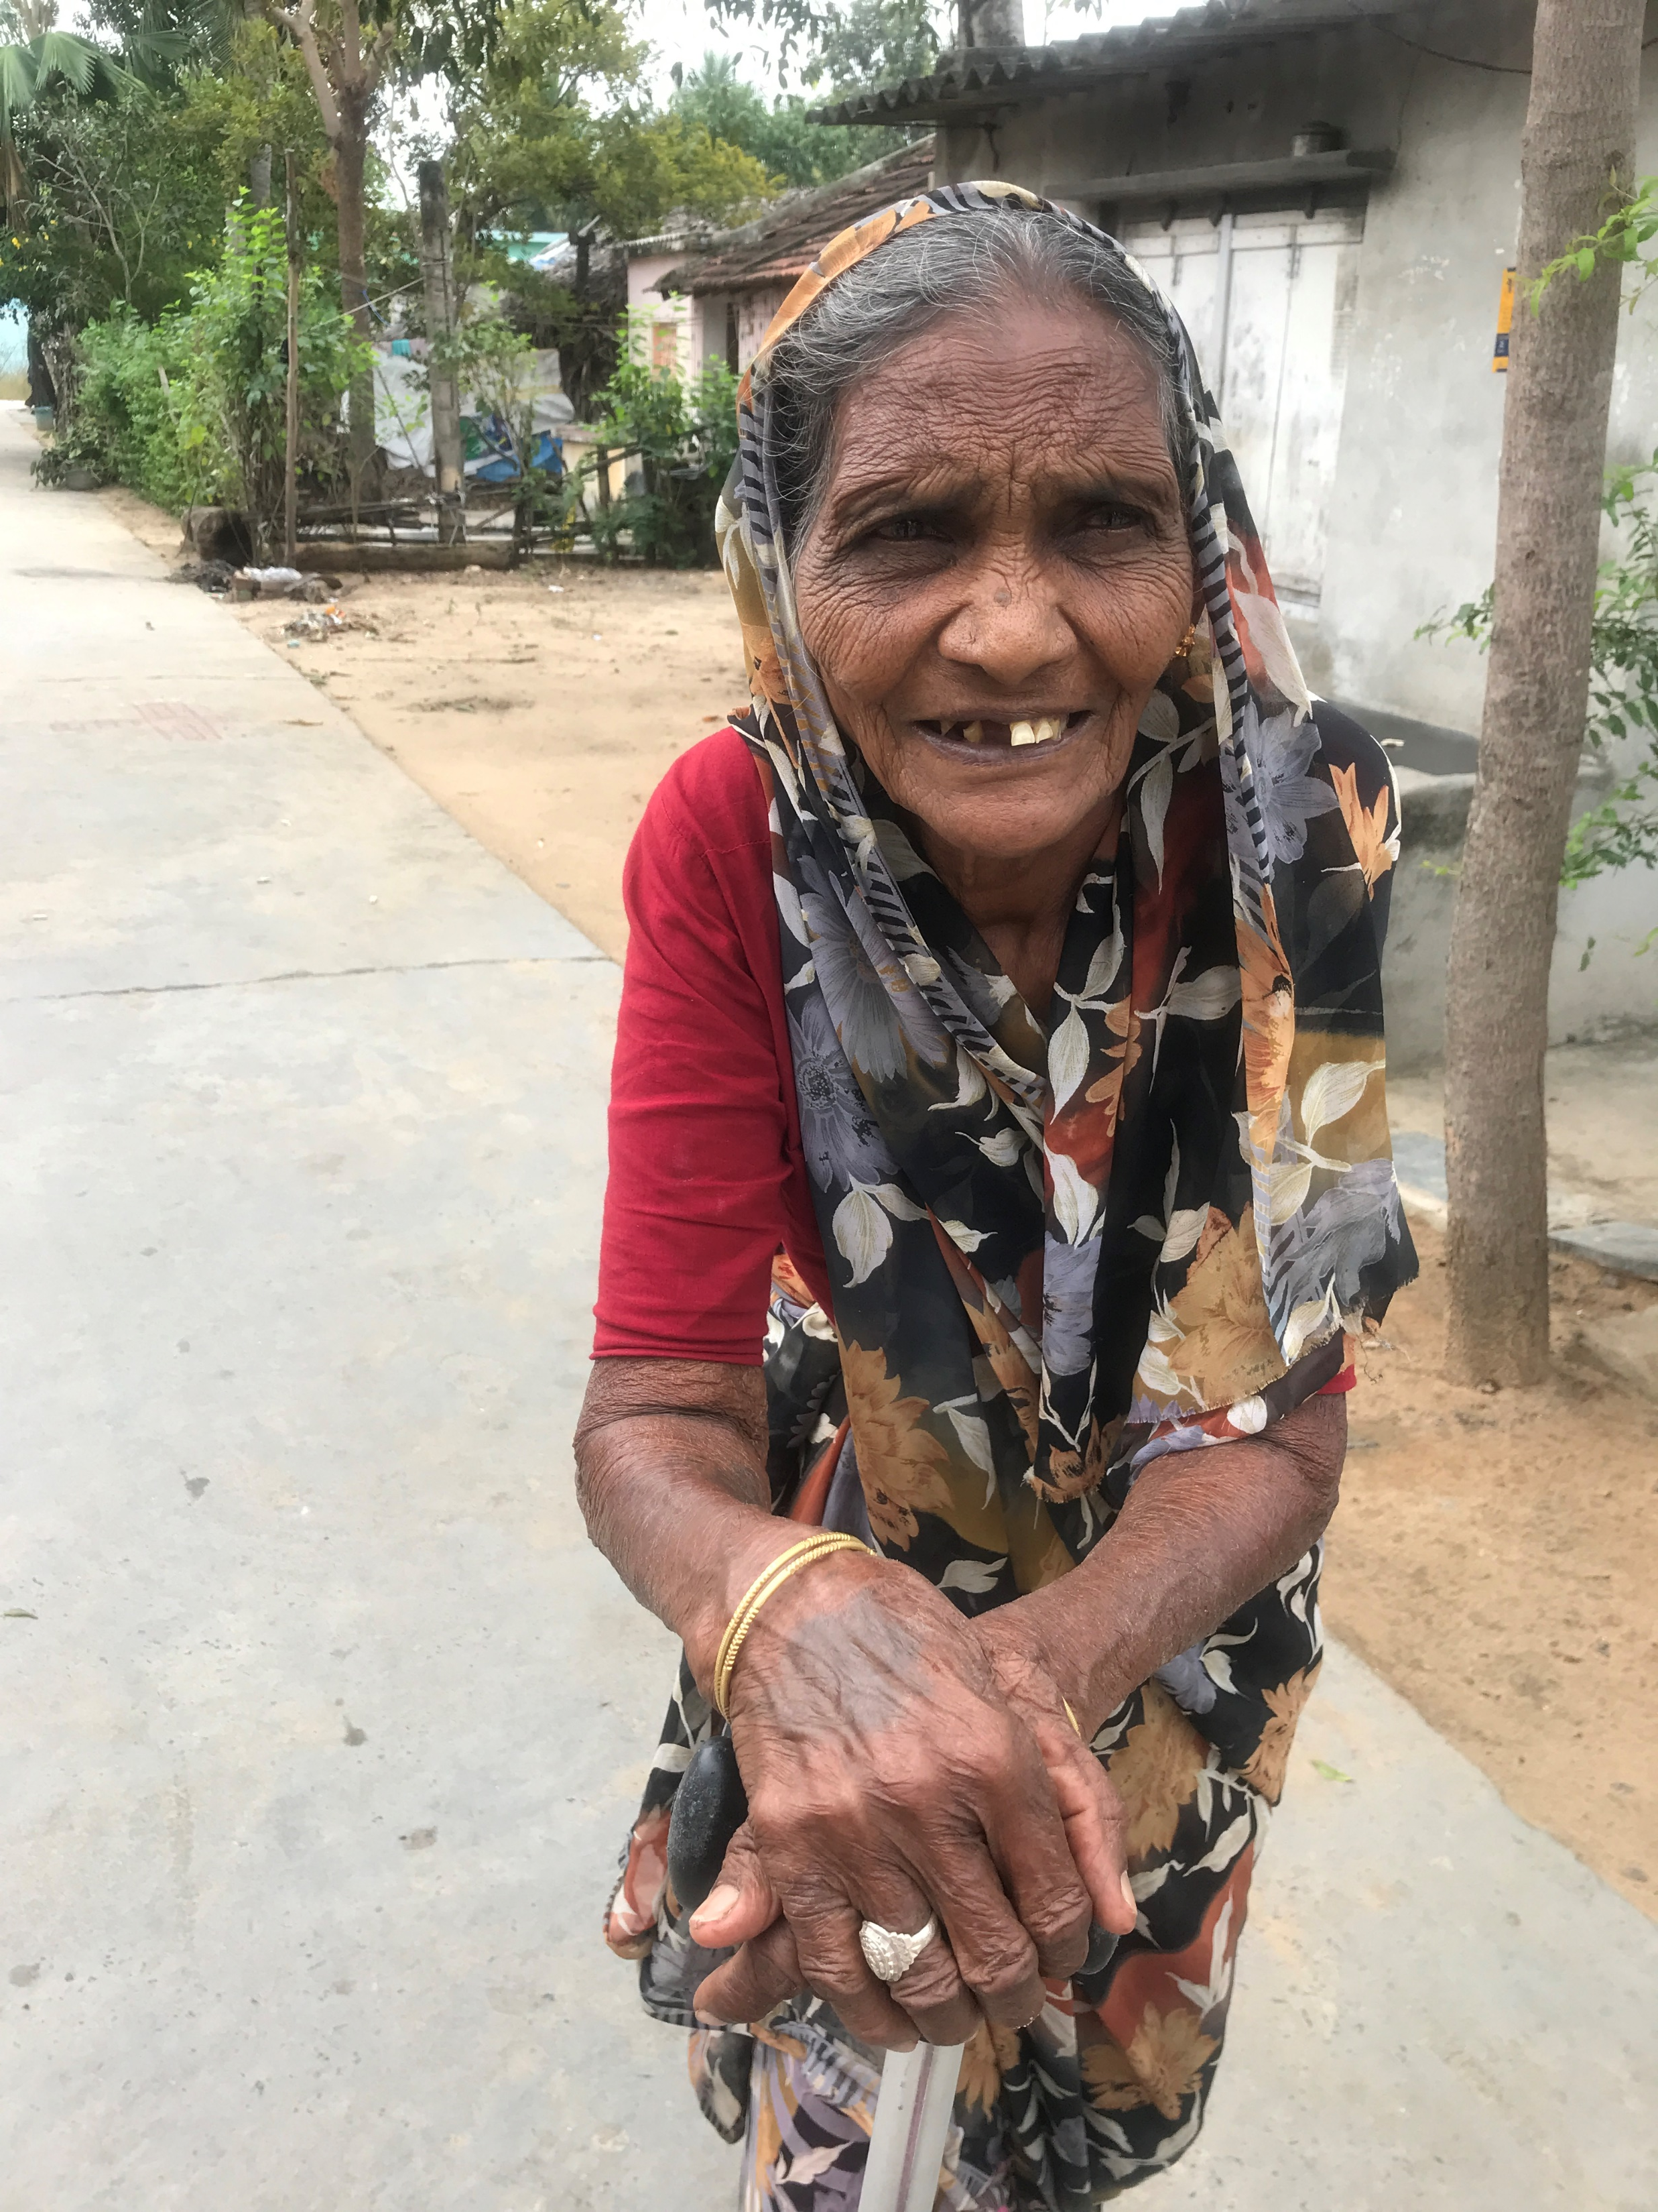

Slide 7
